Slide 1
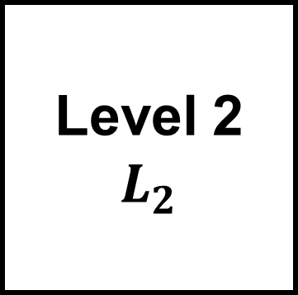
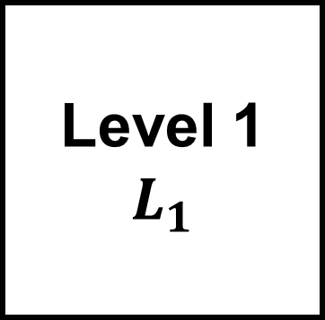
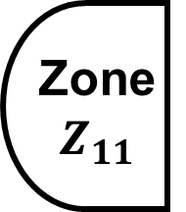
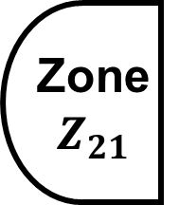

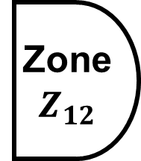
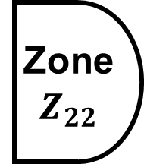




Building
B
Level 1
$$L_{1}$$
Level 2
$$L_{2}$$
HVAC
Room
$$H$$
Small
Room
$$SR_{1}$$
Big Room
$$BR_{1}$$
Small
Room
$$SR_{2}$$
Big Room
$$BR_{2}$$
Zone
$$Z_{11}$$
Zone
$$Z_{12}$$
Zone
$$Z_{21}$$
Zone
$$Z_{22}$$

